Slide 1

eService Client Side Architecture
By Luke Yang
Software Architect

Slide 2
Agenda
Review eService Overall Architecture(approx. 1 min.)
Review Architecture of SanjeleSanjelClient (approx. 5 min.)
Q&A

Slide 3
Review eService Overall Architecture
eService subsystems&components
eService deployment

Slide 4
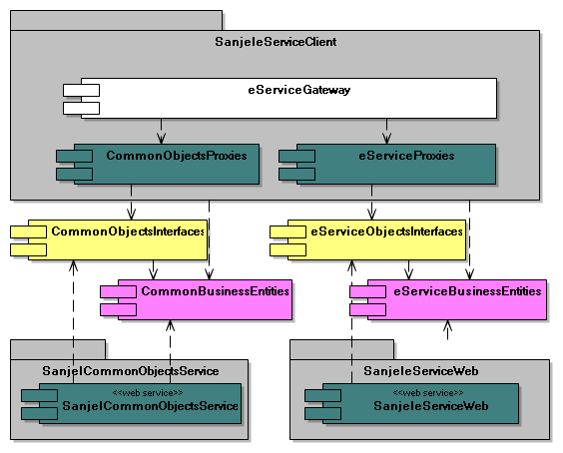
eService Subsystems&Components
Integration
Proxies
Contracts
Schemas
Services

Slide 5
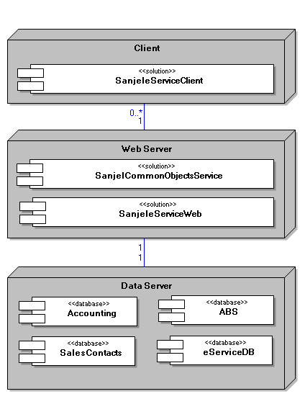
eService Deployment Overview
Clients
  SanjeleServiceClient
Web Server
  SanjeleServiceWeb
  SanjelCommonObjects
Data Server
  ABS
  Accounting
  eServiceDB
  SalesContacts

Slide 6
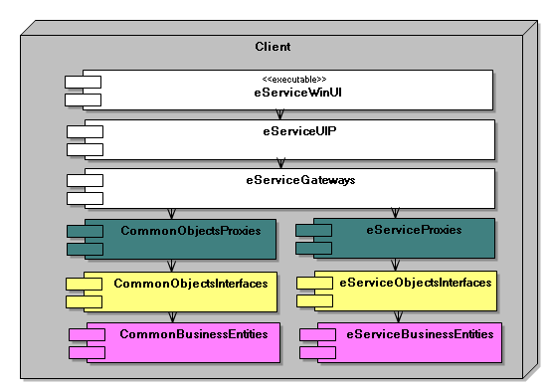
eService Client Deployment

Slide 7
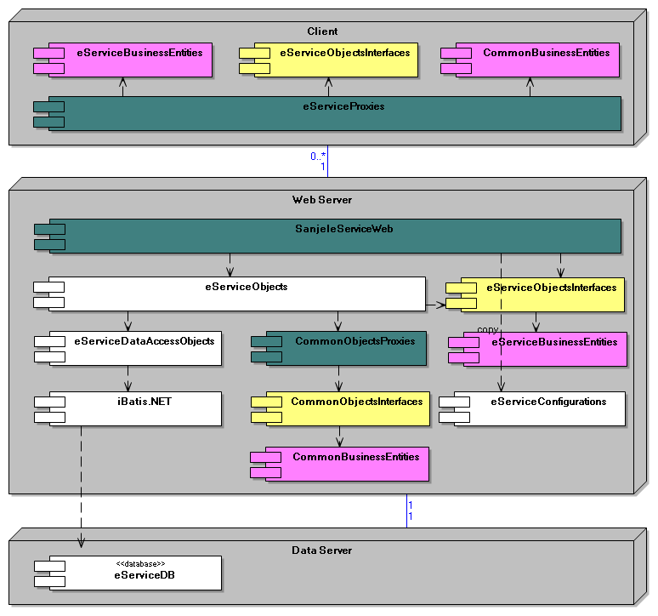
Architecture of SanjeleServiceWeb
Deployments Overview

Slide 8
Architecture of SanjeleSanjelClient
Components Overview
Deployments Overview
Essential Packages and Classes

Slide 9
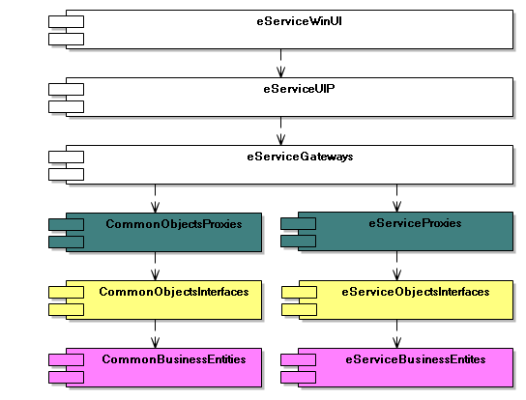
Architecture of SanjeleSanjelClient
Components Overview

Slide 10
Architecture of SanjeleSanjelClient
Deployments Overview

Slide 11
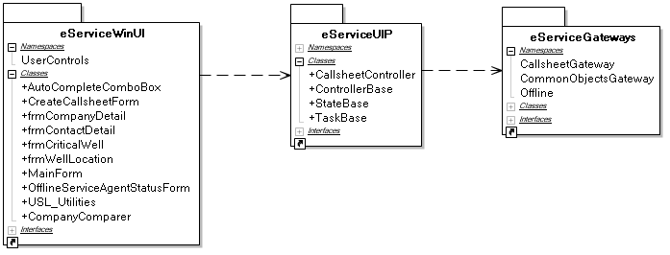
Architecture of SanjeleSanjelClient
Packages Overview

Slide 12
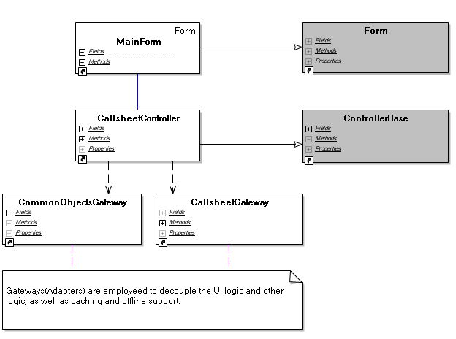
Architecture of SanjeleSanjelClient
Form Controller Gateway

Slide 13
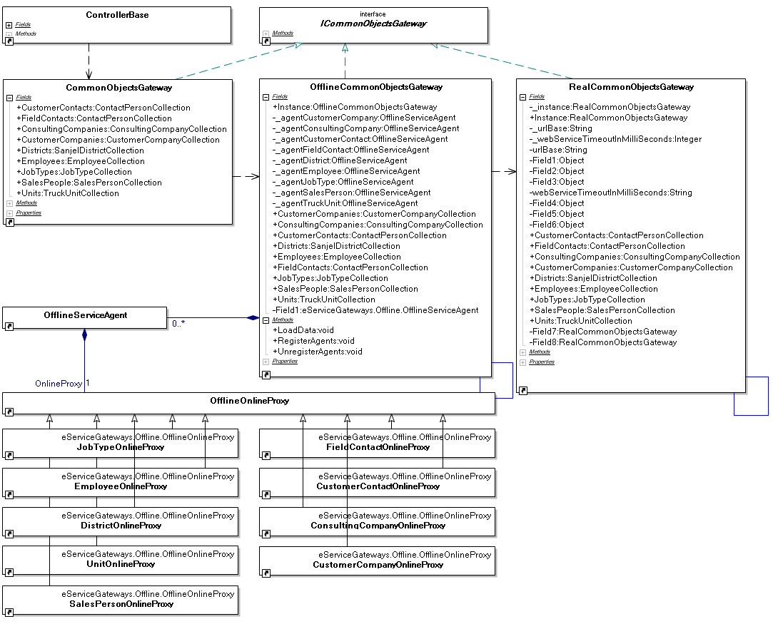
Architecture of SanjeleSanjelClient
CommonObjectsGateway

Slide 14
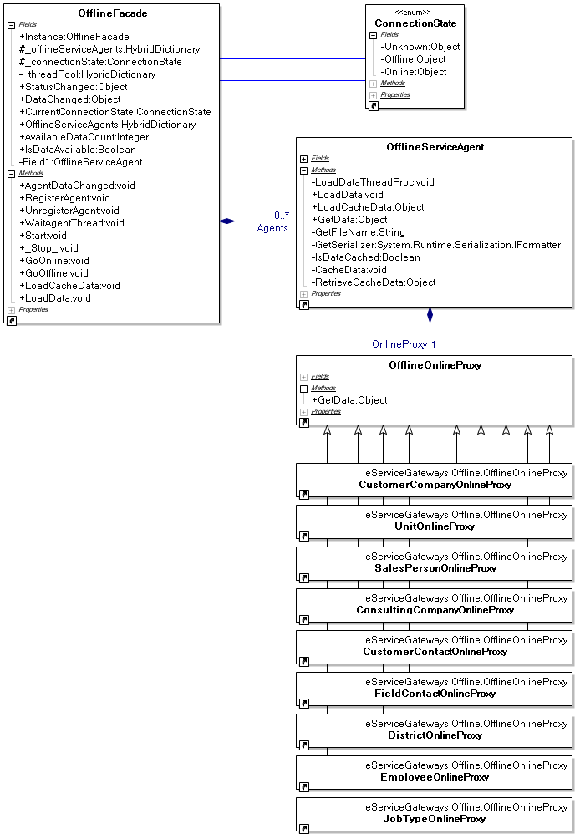
Architecture of SanjeleSanjelClient
Offline Support

